Slide 1







ApplicatioNs of statistics
FOR ENGINEERING
TECHNOLOGY PROGRAMS

Slide 2


IND X
∈
∞
⌛
MEAN AND STANDARD DEVIATION
INTRODUCTION
SIX SIGMA
Ω
REGRESSION
PROBLEMS
CONCLUSION

Slide 3
INTRODUCTON
Statistics is the discipline that concerns the collection, organization, displaying, analysis, interpretation and presentation of data.
Statistics is a critical tool for various things like, robustness analysis, measurement system error analysis, test data analysis, probabilistic risk assessment and etc.
There have been several research efforts in the area of using statistics-related tools in Engineering Technology programs that focus on specific tools in specific courses.
1
2
3

Slide 4
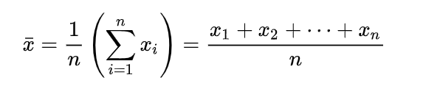

Mean & Standard Deviation
∑
Mean is the central value of a discrete set of numbers.
The standard deviation is a measure of the amount of variation or dispersion of a set of values.
1
2
3
4

Slide 5
SIX SIGMA
Six Sigma is a disciplined, statistical-based and continuous improvement methodology for eliminating defects in a product , process or service.
For example, if a product must have a thickness between 10.32 and 10.38 inches to meet customer requirements, then the process mean should be around 10.35, with a standard deviation less than 0.005 (10.38 would be 6 standard deviations away from 10.35), assuming a normal distribution.
1
2
6σ

Slide 6
REGRESSION
1
2
3
In statistical modeling, regression analysis is a set of statistical processes for estimating the relationships between a dependent variable and one or more independent variables.
Regression is a useful tool for engineers. It could help the engineer identify the relationship between variables based on test data.
Regression analysis is widely used for prediction, forecasting and machine learning. In some situations regression analysis can be used to infer casual relationships between the independent and dependent variables.

Slide 7
SIMPLE LINEAR REGRESSION
1
2
Y = Bo +B1X
X- Value of independent variable.
Y-The value of dependent variable.
B0- is a constant (shows the value of Y when X=0)
B1-The regression coefficient (shows how much Y changes for each unit change in X
Simple linear regression allows us to study the relationship between only two variables.

Slide 8
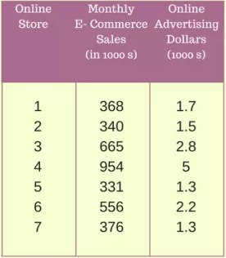
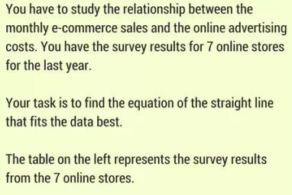
EXAMPLE :

Slide 9
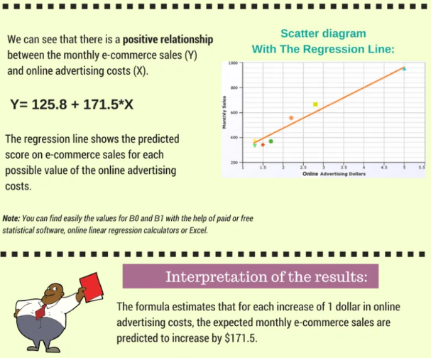

Slide 10
EXAMPLE :
Suppose that IQ scores have a mean of 120 and a standard deviation of 10
1. What is the percentage of people with IQ scores between 100 and 140?
2. What can you say about someone who is 3 standard deviation from the mean?
1. 100 is 2 standard deviations below the mean (100 = 120 - 2 × 10)
140 is 2 standard deviations above the mean (140 = 120 + 2 × 10)
95% of people have a score between 100 and 140
2. Somebody who is 3 standard deviations from the mean could either have a score of 90 or 160
The score of 90 will be considered low and somewhat average while the score of 160 is considered to be gifted.

Slide 11
CONCLUSION
Statistical concepts such as mean, standard deviation, probability distribution, and variation in system parameters are very useful in day to day applications.
Tools and methods such as Six Sigma, Design of Experiments, Monte Carlo analysis, and regression were illustrated with real-world examples.
Students at different levels, from sophomore to senior, learn these concepts and tools in different courses with multiple immersions in to the field of statistics.
Students use professional software extensively for statistical analysis.

Slide 12
THANK
YOU

